Slide 1
Mini Popper | Colt poppers | Pepper poppers | Plates | Wall feet
9 | 4 | 1 | 0 | 59
Bay | Stage | Target Type | Count | NS | Total | Hard Cover
A3 | Don’t Step Too Far | IPSC | 8 | 5 | 13 | 1 Tux 1 Left Diag 2 Right Diag
A2 | U Showdown | IPSC | 7 | 2 | 9 | 1 Tux 1 Left Diag
B1 | 19-02 | IPSC | 4 | 2 | 6
B2 | Outfield Rumble | IPSC | 4 | 2 | 6 | 1 Right Diag
B3 | Twist and Shout | IPSC | 5 | 2 | 7 | 1 Tux 1 Left Diag 2 Right Diag
B4 | One More Minute | IPSC | 9 | 2 | 11 | 1 Tux 1 Left Diag
Stage | Paper | Steel | Total
Don’t Step Too Far | 12 IPSC | 4 | 28
U Showdown | 9 IPSC | 2 | 20
19-02 | 4 IPSC | 4 | 12
Outfield Rumble | 5 IPSC | 2 | 12
Twist and Shout | 9 IPSC | 1 | 19
One More Minute | 11 IPSC | 1 | 12
Total | 39 | 14 | 103

Slide 2
Prop | Stage
Max trap | 1 – A3
Fall forward popper | 1 – A3
Swinger | 2 – A2
Swinger | 3 – B2
Type | Style | Count
IPSC | Tux | 4
IPSC | Left Diag | 4
IPSC | Right Diag | 5
IPSC | 50.00% | 0

Slide 3

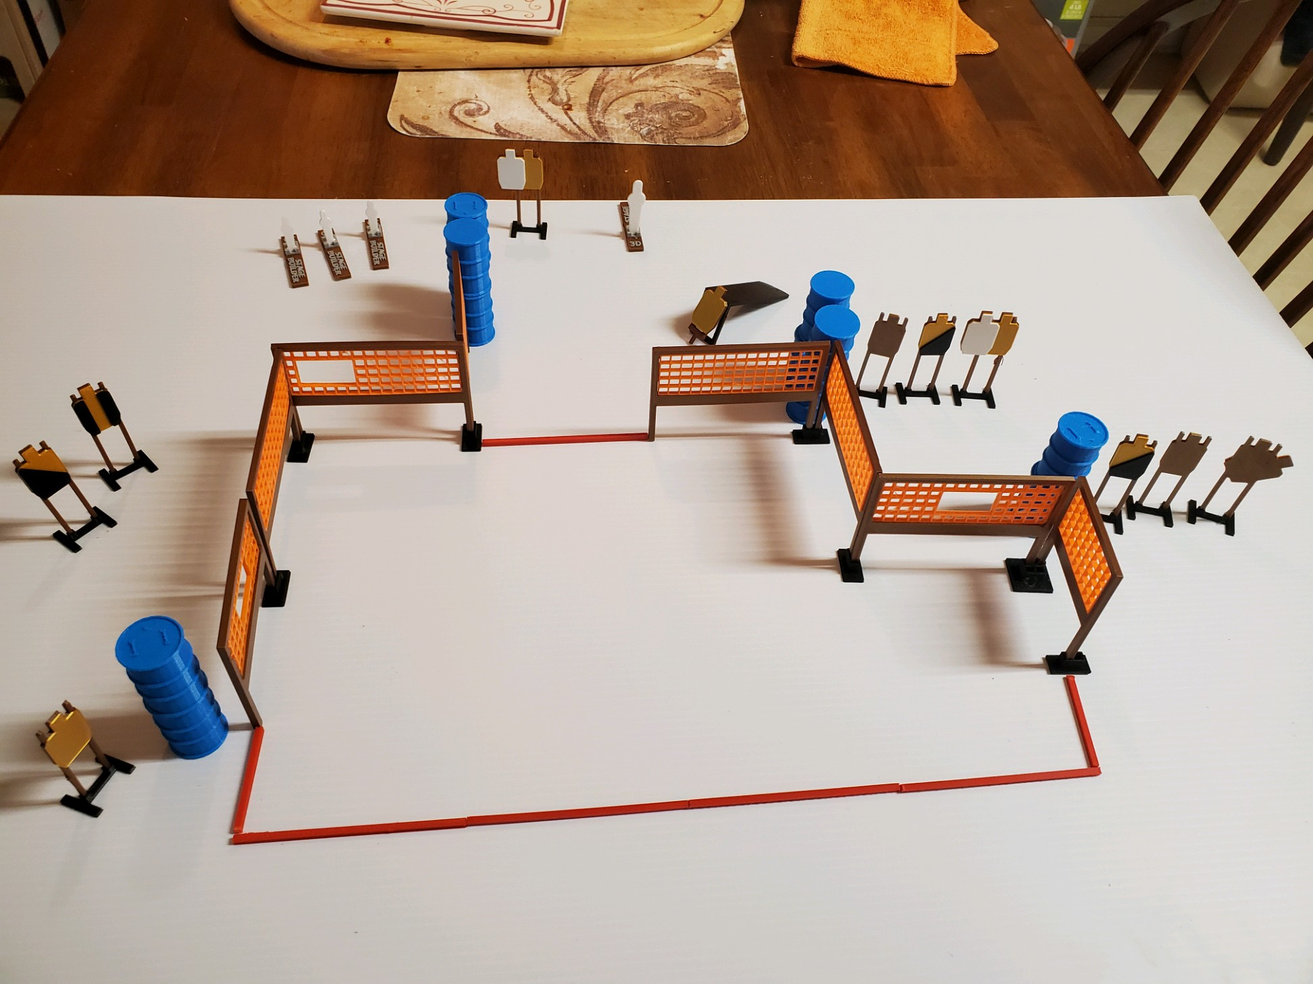
 | Dothan Practical Shooters – USPSA Match Don’t Step Too Far Course Designer : Jerry Copeland Bay: A3
Round Count 32 rounds 11 IPSC 3 minis, 1 fall forward popper
Equipment List Max trap 10 wall feet Max trap + activator 1 left diag, 2 right diag, 1 tux 12 targets (6 + 5NS)

Slide 4
Don’t Step Too Far
Written Stage Briefing
Scoring: Comstock Rounds: 32
Targets: 14 IPSC, 4 steel
Handgun start position: feet on X’s, wrists below belt. Handgun is loaded and holstered.
PCC start position: feet on X’s, stock on belt. Loaded carbine is held with both hands, safety on.
Stage Procedure: on the audible start signal, engage target as they become available from within the shooting area. The max trap is activated by P4 and remains visible at rest.

Slide 5
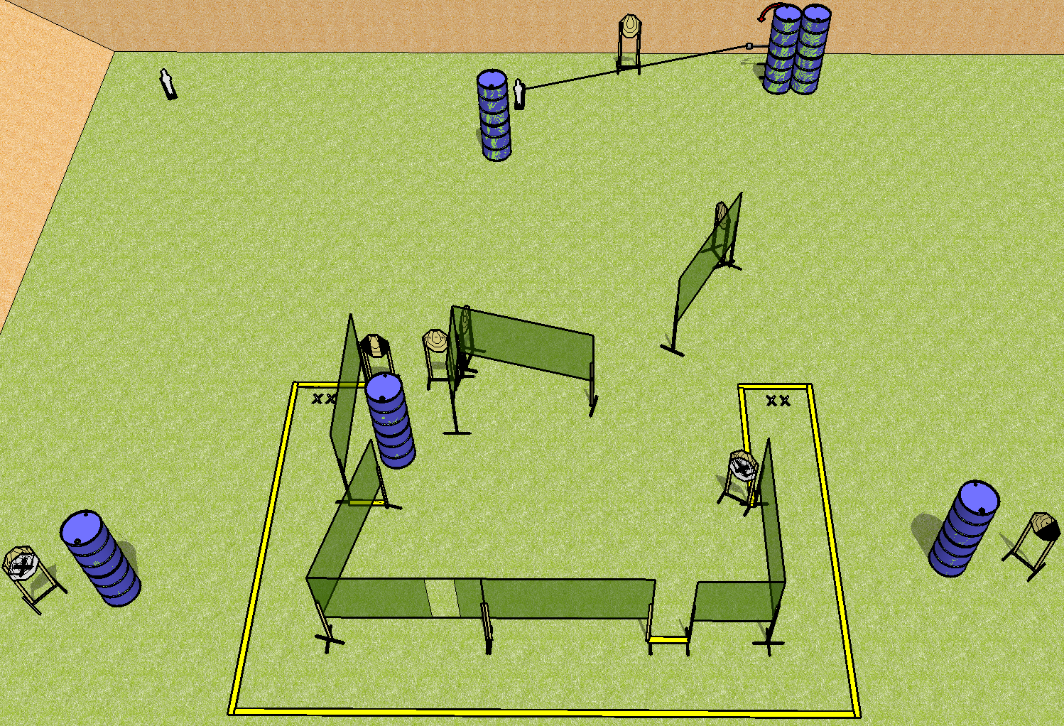
 | Dothan Practical Shooters – USPSA Match U Showdown Course Designer : Drew Coleman Bay: A2
Round Count 20 9 IPSC 2 mini poppers
Equipment List 15 wall feet 1 swinger + activator 1 left diag, 1 tux 9 targets (7 + 2NS)

Slide 6
U Showdown
Written Stage Briefing
Scoring: Comstock Rounds: 20
Targets: 9 IPSC, 2 steel
Handgun start position: feet on either set of X’s, wrists below belt. Handgun is loaded and holstered.
PCC start position: feet on either set of X’s, stock on belt. Loaded carbine is held with both hands, safety on.
Stage Procedure: on the audible start signal, engage targets as they become available from within the shooting area.

Slide 7
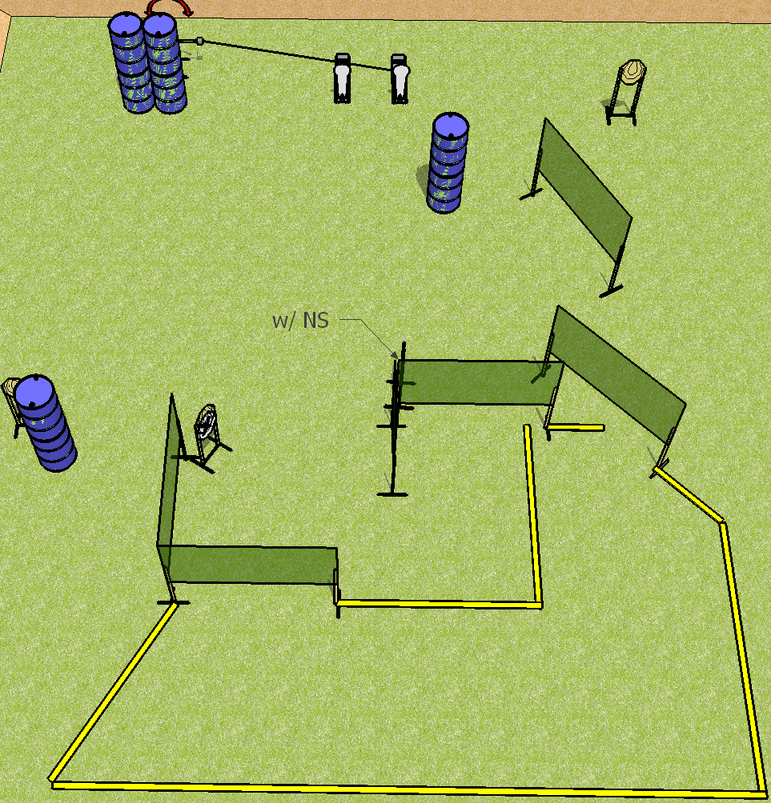
 | Dothan Practical Shooters – USPSA Match Outfield Rumble Course Designer : Drew Coleman Bay: B2
Round Count 12 rounds 5 IPSC 2 colt poppers
Equipment List 10 wall feet Swinger + activator 1 right diag 6 targets (4 + 2NS)

Slide 8
Outfield Rumble
Written Stage Briefing
Scoring: Comstock Rounds: 12
Targets: 5 IPSC, 2 steel
Handgun start position: anywhere completely outside the shooting area, wrists below belt. Handgun is loaded and holstered.
PCC start position: anywhere completely outside the shooting area, stock on belt. Loaded carbine is held with both hands, safety on.
Stage Procedure: on the audible start signal, engage targets as they become available from within the shooting area. The swinger is activated by either popper and remains visible at rest.

Slide 9
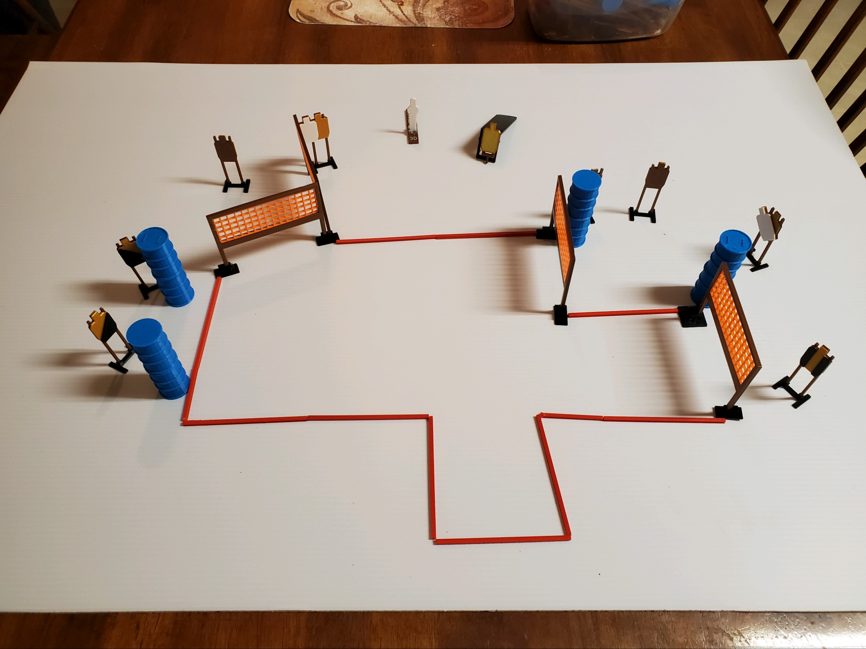
 | Dothan Practical Shooters – USPSA Match Twist and Shout Course Designer : Jerry Copeland Bay: B3
Round Count 19 rounds 9 IPSC 1 colt popper
Equipment List 7 wall feet 1 left diag, 2, right diag, 1 tux 7 targets (5 + 2NS)

Slide 10
Twist and Shout
Written Stage Briefing
Scoring: Comstock Rounds: 19
Targets: 9 IPSC, 1 steel
Handgun start position: heels touching rearmost fault line, wrists below belt. Handgun is loaded and holstered.
PCC start position: heels touching rearmost fault line, stock on belt. Loaded carbine is held with both hands, safety on.
Stage Procedure: on the audible start signal, engage target as they become available from within the shooting area. The drop turner is activated by P1 and is a disappearing target.
Last target on scorepad will have NPM’s.

Slide 11
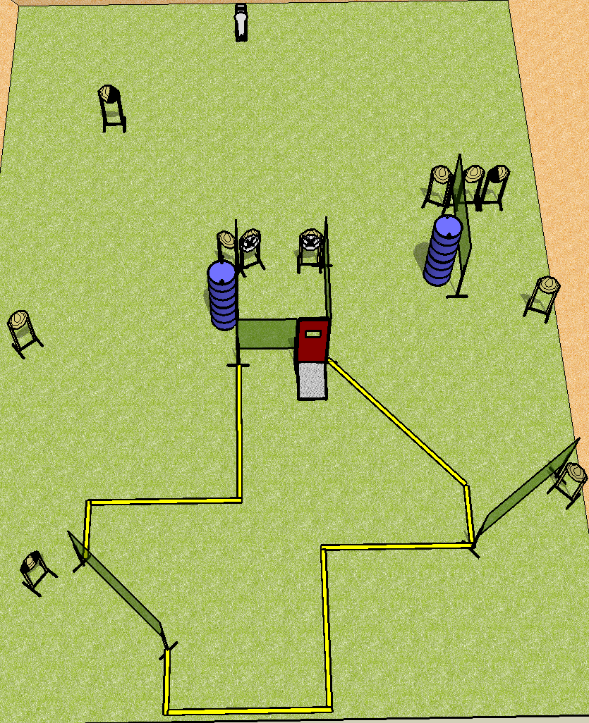
 | Dothan Practical Shooters – USPSA Match Just One More Minute Course Designer : Drew Coleman Bay: B4
Round Count 12 rounds 11 IPSC 1 colt popper
Equipment List 11 wall feet Pull cord port 1 tux, 1 left diag, 1 right diag 10 targets (8 + 2NS)

Slide 12
Just One More Minute
Written Stage Briefing
Scoring: Comstock Rounds: 12 rounds. Best one hit per target
Targets: 11 IPSC, 1 steel
Handgun start position: inside shooting box at port, wrists below belt. Handgun is UNLOADED and holstered.
PCC start position: inside shooting box at port, stock on belt. UNLOADED carbine is held with both hands.
Stage Procedure: on the audible start signal, engage targets as they become available from within the shooting area.
The box at the port is part of the shooting area.

